Slide 1
Used Car Price Prediction
Rohan V Borade

Slide 2
Data Set
Used car price prediction
Source : I have created data using the selenium from the various sites.
Abstract :
Number of Instances (5493)
Attributes (Float, Integer, String)
Number Of Attributes (8) –
Brand, Variant ,Transmission, Owner, Kilometer ,Fuel ,Year_of_purchase, Location, Price

Slide 3
Problem Statement
With the covid 19 impact in the market, we have seen lot of changes in the car market. Now some cars are in demand hence making them costly and some are not in demand hence cheaper. One of our clients works with small traders, who sell used cars. With the change in market due to covid 19 impact, our client is facing problems with their previous car price valuation machine learning models. So, they are looking for new machine learning models from new data. We have to make car price valuation model.
What to achieve:(Used car price)
Best price for the used car.

Slide 4
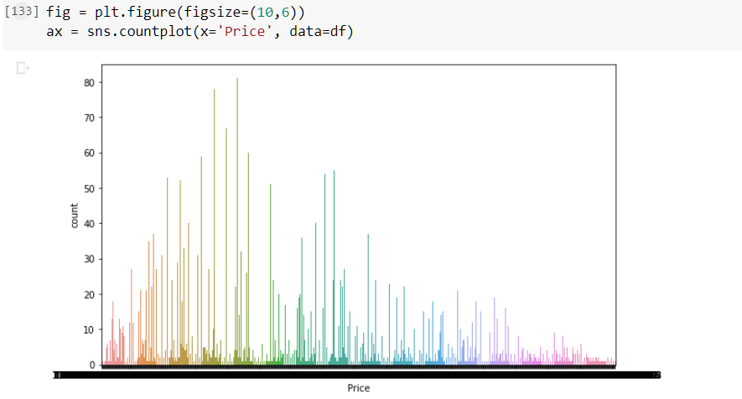
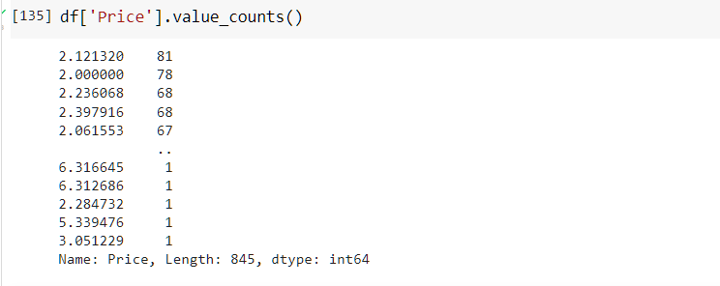
Data Exploration & Facts
Data set target column classified as below

Slide 5
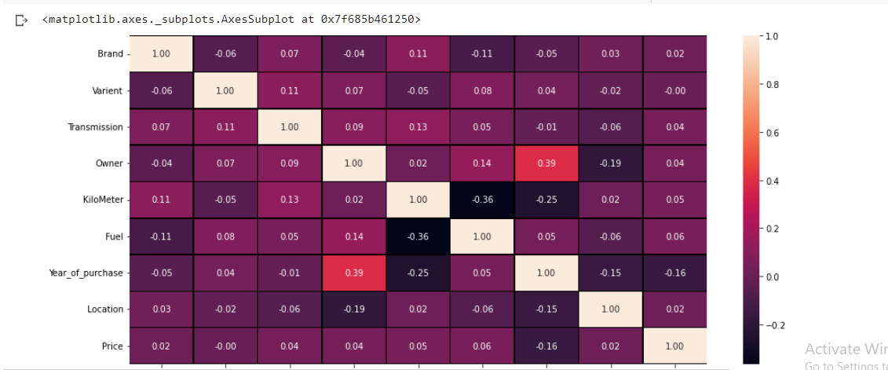
Attribute’s Correlation & Recommendations
Below plot shows mutual relation between attributes , correlation increases from light to dark color.
Recommendations- Used Cars Price Prediction depends upon below –
Now some cars are in demand hence making them costly and some are not in demand hence cheaper. One of our clients works with small traders, who sell used cars. With the change in market due to covid 19 impact, our client is facing problems with their previous car price valuation machine learning models. So, they are looking for new machine learning models from new data.

Slide 6
Requirement of Machine Learning
Will try to find out accurate prediction for Used Car Price for the Client.
To achieve this result , will build Regression model.

Slide 7
Supervised Learning methods :
Linear Regression – Hyper parameters
KNN Resgressor – Best neighbor get picked
Decision Tree Regressor – Node Splitting on all available variables.
Lasso – Hyper Parameters
Ridge – Hyper parameters
Ensemble Techinque's --
Gradient Boost regressor, XGB Regressor,
Ada Boost regressor,Support vector regressor

Slide 8
Model Training Using Numbers Of Folds = 4
Linear Regression – Accuracy score achieved 44.7148999220649%
KNN Regressor – Accuracy score achieved 53.89650823287294%
Decision Tree Regressor – Accuracy score achieved 73.7555373784057%
Lasso – Accuracy score achieved 45.20133559139351%
Ridge -- Accuracy score achieved 45.19408844383788%
Gradient Boost regressor -- Accuracy score achieved 82.71799688842563%
XGB Regressor -- Accuracy score achieved 88.85240510454851%
Ada Boost regressor -- Accuracy score achieved 52.40225971771041 %
Support vector regressor -- Accuracy score achieved 59.28771150880987%

Slide 9
Thank you

